Slide 1

Simple Voting System Project
A comprehensive implementation of an electronic voting system demonstrating fundamental programming concepts and democratic principles through C programming.
TEAM DETAILS:
N.LAKSHMI SREE
D.JAHNAVI
REHAN
B.JAGADISH

Slide 2

Abstract
This project presents a comprehensive implementation of a simple voting system designed to simulate the democratic election process through programming. The system enables voters to cast their votes for candidates in a secure and straightforward manner whilst ensuring accurate vote counting through efficient algorithms.
The implementation demonstrates fundamental programming concepts including arrays for data storage and loops for iterative processing. Our primary aim is to provide a transparent, easy-to-understand voting mechanism that serves as an excellent educational tool whilst maintaining the integrity of the voting process.

Slide 3

Introduction
The Democratic Foundation
Voting represents the cornerstone of democratic governance, enabling citizens to select their representatives and shape their future. Traditional voting systems have evolved from paper ballots to sophisticated Electronic Voting Machines (EVMs).
Our system models a simple yet effective electronic voting process using C programming language, focusing on three key principles: clarity in operation, simplicity in implementation, and correctness in vote counting.

Slide 4
Applications
Small-Scale Elections
Ideal prototype for conducting polls, surveys, or elections in limited environments. Can be deployed quickly for immediate voting needs.
Organizational Use
Easily adaptable for club elections, student council voting, committee selections, and organizational decision-making processes.

Slide 5
Existing Methodology
1
2
Manual Paper Ballots
Electronic Voting Machines
Traditional voting using physical ballot papers marked by voters. Requires manual counting by election officials, making it time-intensive and prone to human errors during tabulation.
Specialized hardware devices that record and count votes electronically. Whilst faster than manual counting, they require significant investment in equipment, maintenance, and security infrastructure.
3
4
Online Voting Systems
Centralized Systems
Web-based platforms allowing remote voting. Offer convenience but face substantial challenges in voter authentication, preventing multiple voting, and protecting against cyber attacks.
Most existing systems rely on centralized counting mechanisms with complex data structures, requiring specialized knowledge to operate and verify.

Slide 6

Drawbacks of Existing Methodology
Manual Counting Issues
Extremely time-consuming process
High probability of human error
Requires extensive manpower
Difficult to verify accuracy
EVM Limitations
Expensive hardware investment
Requires trained personnel
Maintenance and storage costs
Limited transparency in functioning
Online System Risks
Vulnerable to hacking attempts
Voter impersonation threats
Network dependency issues
Complex authentication needs
Complexity Challenges
Reduced voter transparency
Difficult to audit
Technical expertise required
Trust issues among users

Slide 7

Proposed Methodology
Our Approach
01
Array-Based Storage
Implement vote storage using simple arrays in C programming, ensuring efficient memory usage and quick access.
02
Loop-Based Processing
Utilize loops to iterate through votes systematically, ensuring accurate counting and tabulation.
03
Clear User Interface
Provide an intuitive interface for casting votes and displaying real-time results with transparency.
04
Transparency First
Emphasize clarity and ease of understanding over unnecessary complexity, making the system accessible to all.

Slide 8
Advantages of Proposed Methodology
Cost-Effective Solution
Educational Value
Runs on any basic computer system without requiring specialized or expensive hardware infrastructure. Minimal investment needed for implementation.
Easy to understand, modify, and enhance for learning purposes. Demonstrates core programming concepts applied to real-world democratic processes.
Speed & Accuracy
Practical Application
Provides lightning-fast vote counting with minimal chance of computational errors. Results available immediately after voting concludes.
Bridges the gap between theoretical programming knowledge and practical problem-solving in real-world scenarios.

Slide 9
Architecture & Implementation
Input Phase
Number of candidates and voter choices
Storage
Array to hold vote counts per candidate
Processing
Loop through votes to increment counts
Output
Display results and winner",

Slide 10
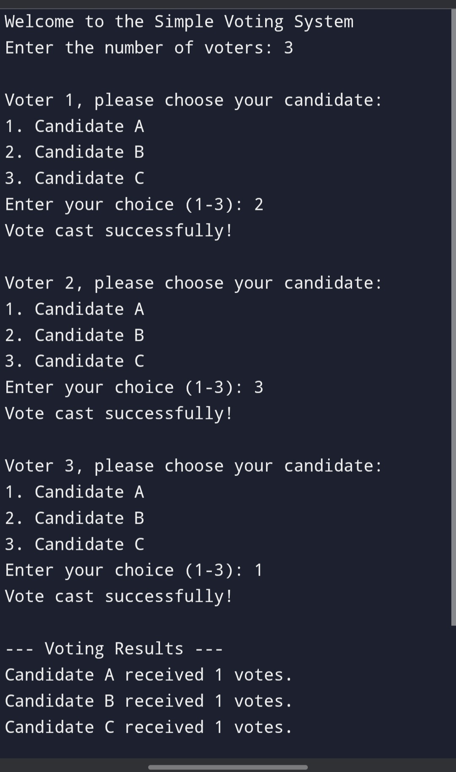
RESULTS

Slide 11
CONCLUSION
This Simple Voting System successfully demonstrates how fundamental programming concepts can be applied to solve real-world democratic processes. By utilizing arrays and loops in C, we've created a transparent, efficient, and educational tool that maintains voting integrity whilst remaining accessible to learners and practical for small-scale implementations. The system serves as an excellent foundation for understanding both voting mechanics and programming principles.

Slide 12
THANK YOU

Slide 13
ANY QUERIES?

